Slide 1
Solving Nonlinear Equations
Author: Autar Kaw et. al.
TEXTBOOK: NUMERICAL METHODS WITH APPLICATIONS

Slide 2
Bisection Method

Slide 3
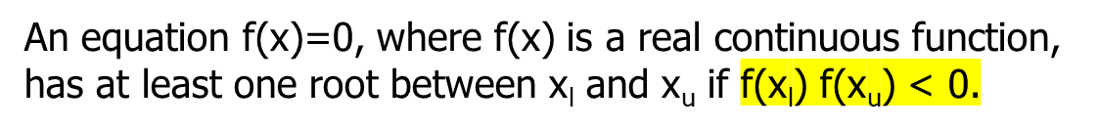
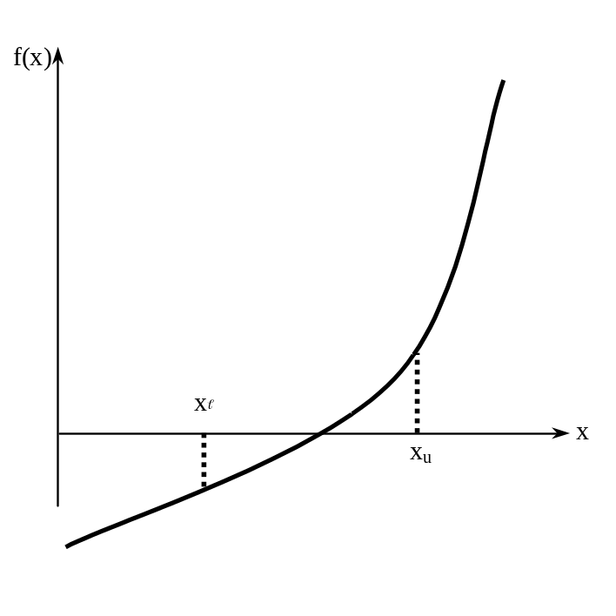
Basis of Bisection Method
Theorem

Slide 4
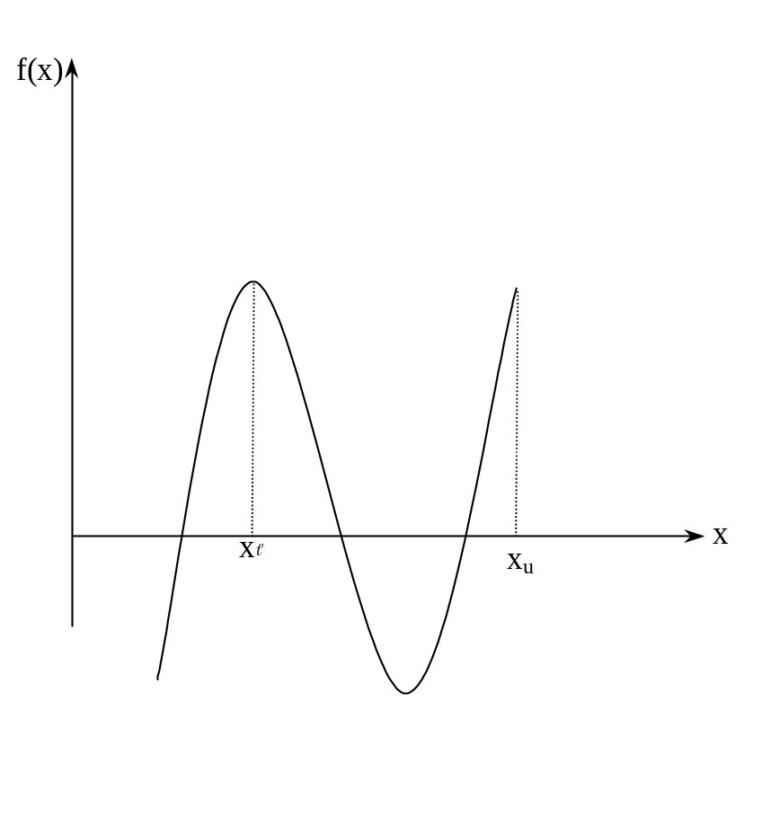




Basis of Bisection Method
Figure 2 If function does not change sign between two points, roots of the equation may still exist between the two points.

Slide 5
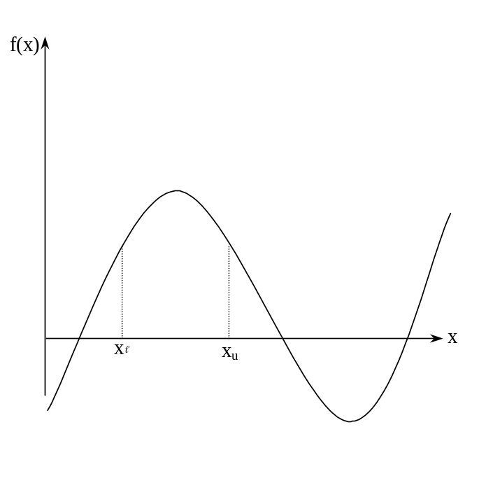
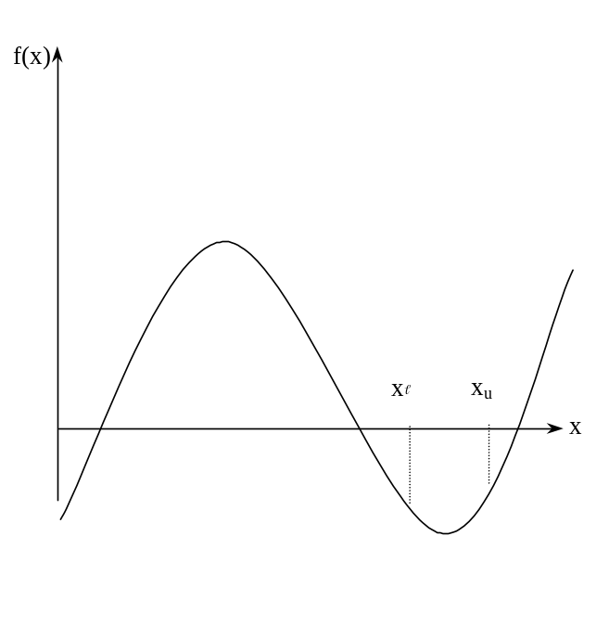
Basis of Bisection Method
Figure 3 If the function does not change sign between two points, there may not be any roots for the equation between the two points.

Slide 6
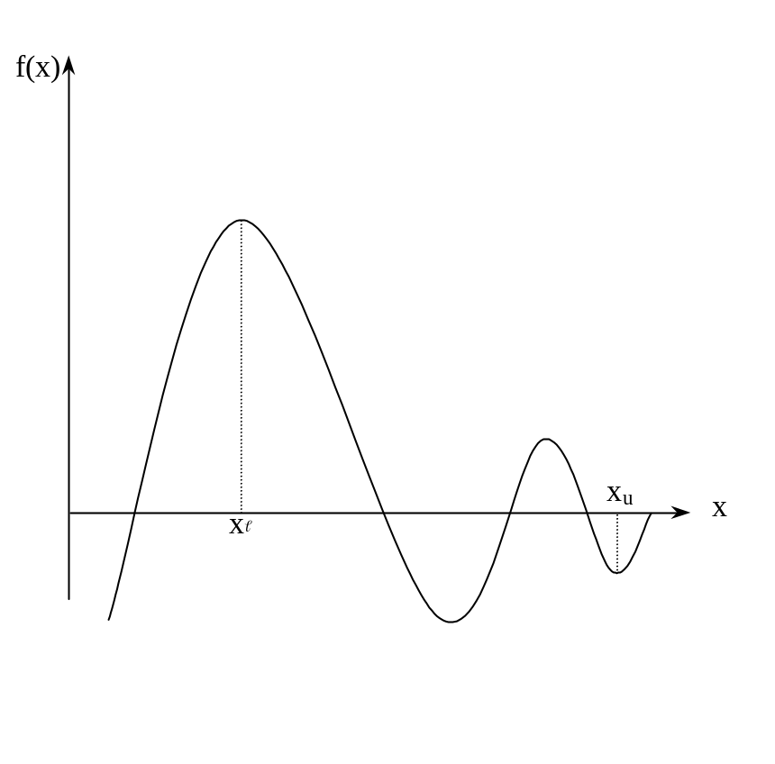


Basis of Bisection Method
Figure 4 If the function changes sign between two points, more than one root for the equation may exist between the two points.

Slide 7
Algorithm for Bisection Method

Slide 8
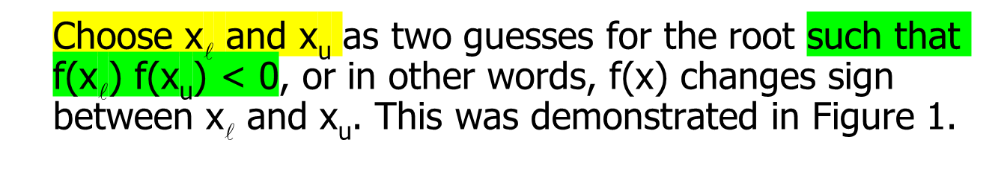
Step 1
Figure 1

Slide 9
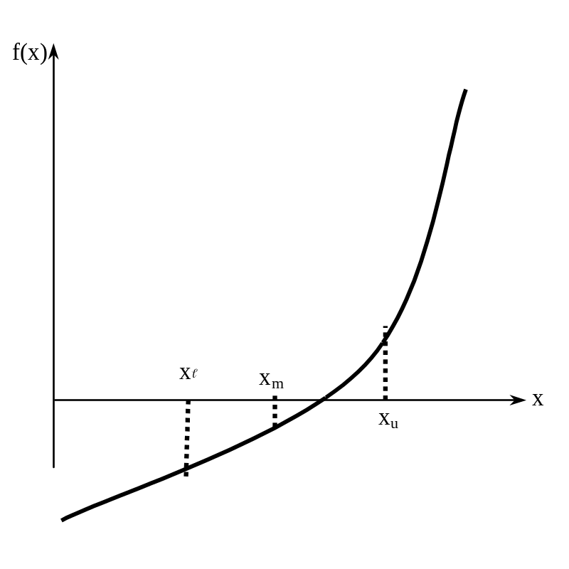
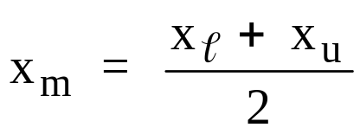


Step 2
Estimate the root, x_{m} of the equation f (x) = 0 as the mid point between x and x_{u} as
Figure 5 Estimate of x_{m}

Slide 10













Now check the following
If , then the root lies between x and x_{m}; then x = x ; x_{u} = x_{m}.
If , then the root lies between x_{m} and x_{u}; then x = x_{m}; x_{u} = x_{u}.
If ; then the root is x_{m.} Stop the algorithm if this is true.

Slide 11

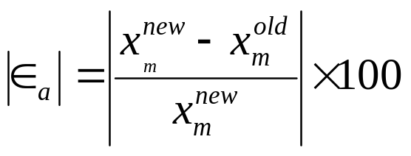





Step 4
Find the new estimate of the root
Find the absolute relative approximate error
where

Slide 12
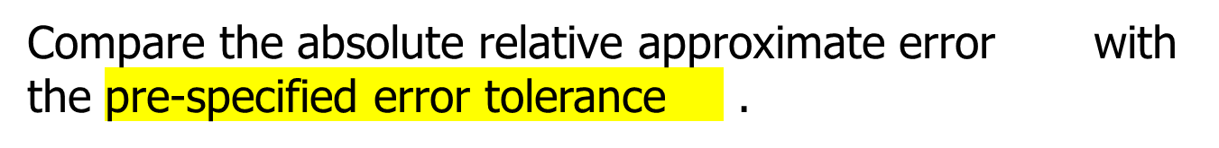
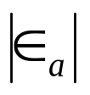


Step 5
Go to Step 2 using new upper and lower guesses.
Yes
Is ?
No
Stop the algorithm
Note one should also check whether the number of iterations is more than the maximum number of iterations allowed. If so, one needs to terminate the algorithm and notify the user about it.

Slide 13


You are working for ‘DOWN THE TOILET COMPANY’ that makes floats for ABC commodes. The floating ball has a specific gravity of 0.6 and has a radius of 5.5 cm. You are asked to find the depth to which the ball is submerged when floating in water.
Figure 6 Diagram of the floating ball

Slide 14
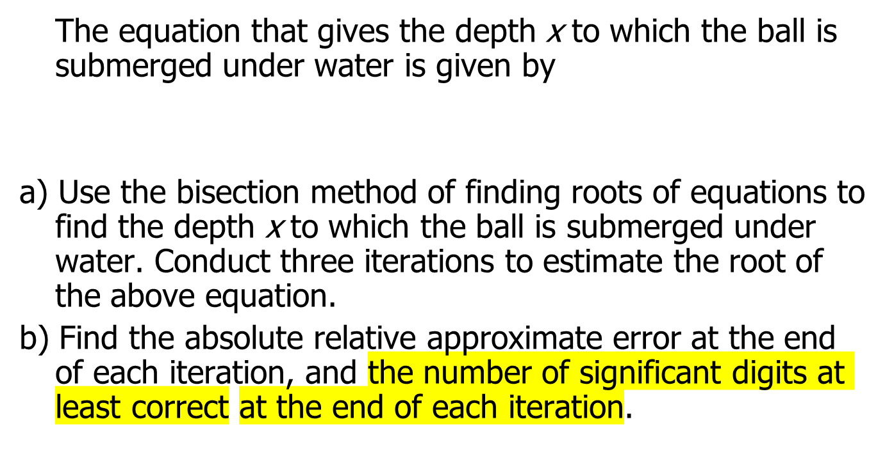

Example 1 Cont.

Slide 15
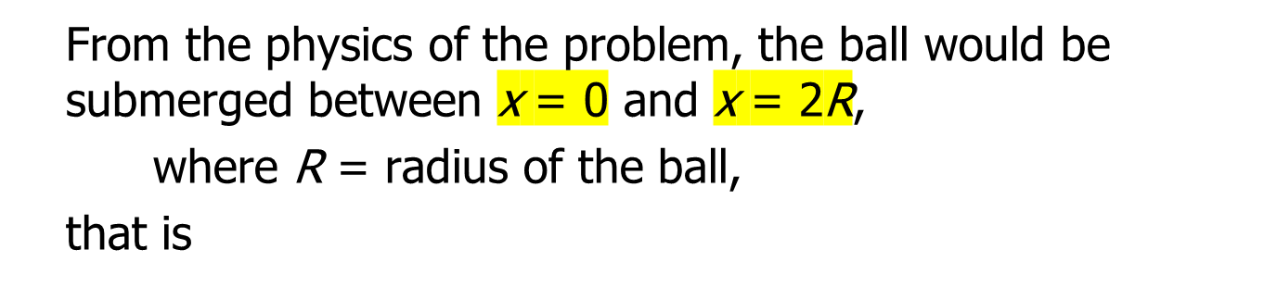
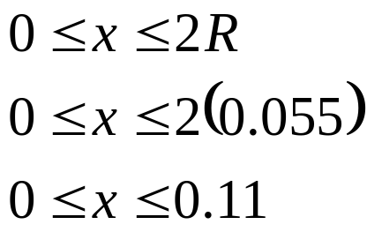

Example 1 Cont.
Figure 6 Diagram of the floating ball

Slide 16
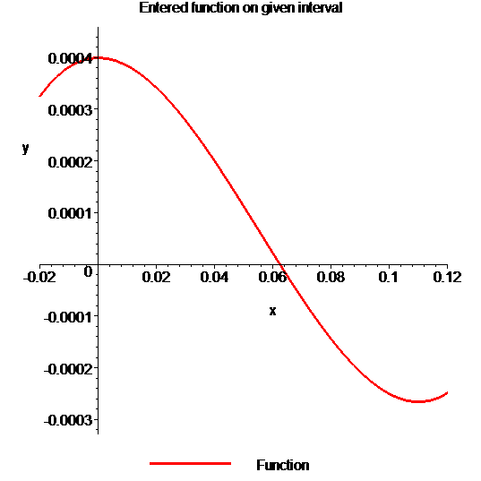
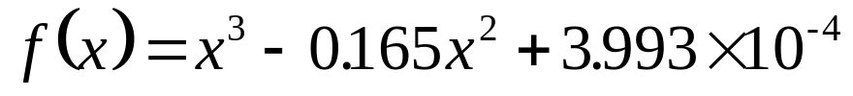
Example 1 Cont.
Solution
To aid in the understanding of how this method works to find the root of an equation, the graph of f(x) is shown to the right,
where
Figure 7 Graph of the function f(x)

Slide 17
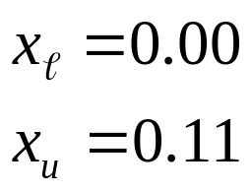


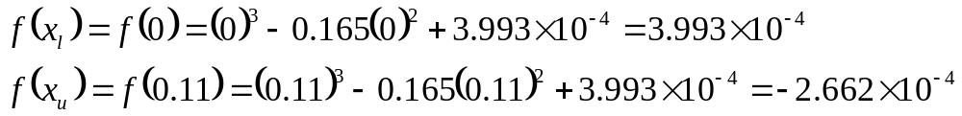
Example 1 Cont.
Let us assume
Check if the function changes sign between x and x_{u .}
Hence
So there is at least on root between x and x_{u,} that is between 0 and 0.11

Slide 18
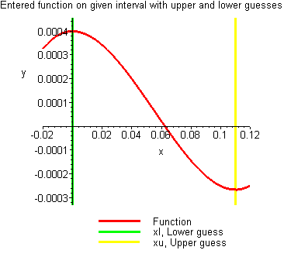
Example 1 Cont.
Figure 8 Graph demonstrating sign change between initial limits

Slide 19
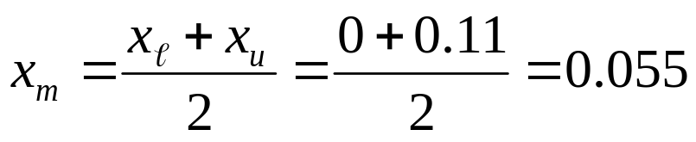
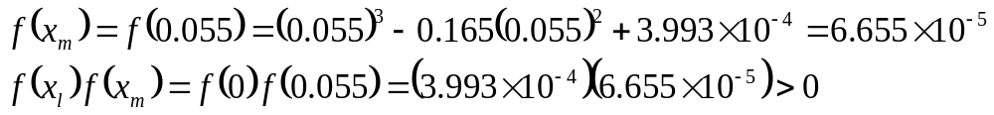






Example 1 Cont.
Iteration 1
The estimate of the root is
Hence the root is bracketed between x_{m} and x_{u}, that is, between 0.055 and 0.11. So, the lower and upper limits of the new bracket are
At this point, the absolute relative approximate error cannot be calculated as we do not have a previous approximation.

Slide 20
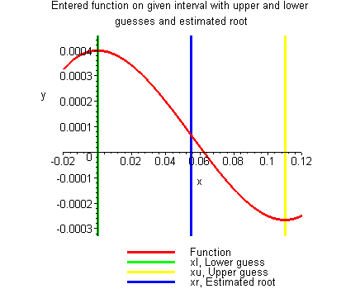
Example 1 Cont.
Figure 9 Estimate of the root for Iteration 1

Slide 21
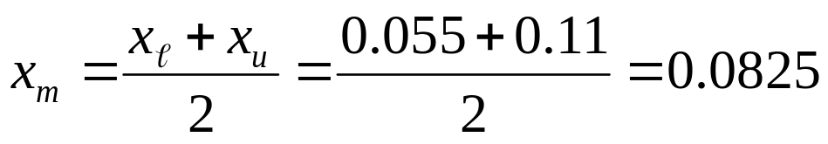
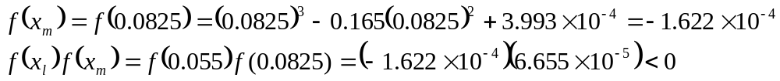

Example 1 Cont.
Iteration 2
The estimate of the root is
Hence the root is bracketed between x and x_{m}, that is, between 0.055 and 0.0825. So, the lower and upper limits of the new bracket are

Slide 22
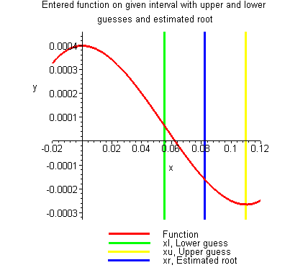
Example 1 Cont.
Figure 10 Estimate of the root for Iteration 2

Slide 23

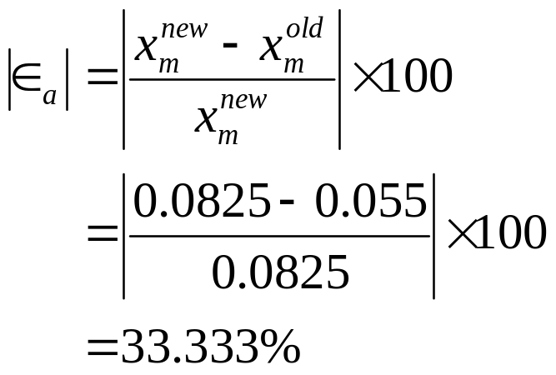


Example 1 Cont.
The absolute relative approximate error at the end of Iteration 2 is
None of the significant digits are at least correct in the estimate root of x_{m} = 0.0825 because the absolute relative approximate error is greater than 5%.

Slide 24
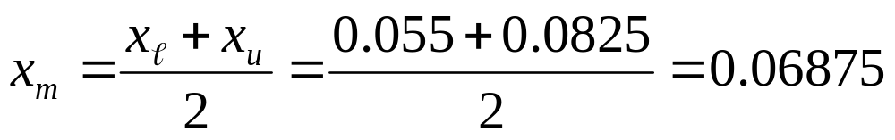
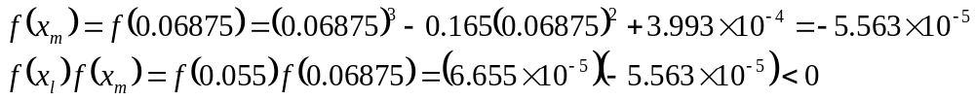

Example 1 Cont.
Iteration 3
The estimate of the root is
Hence the root is bracketed between x and x_{m}, that is, between 0.055 and 0.06875. So, the lower and upper limits of the new bracket are

Slide 25
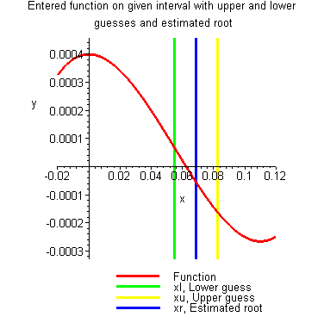
Example 1 Cont.
Figure 11 Estimate of the root for Iteration 3

Slide 26
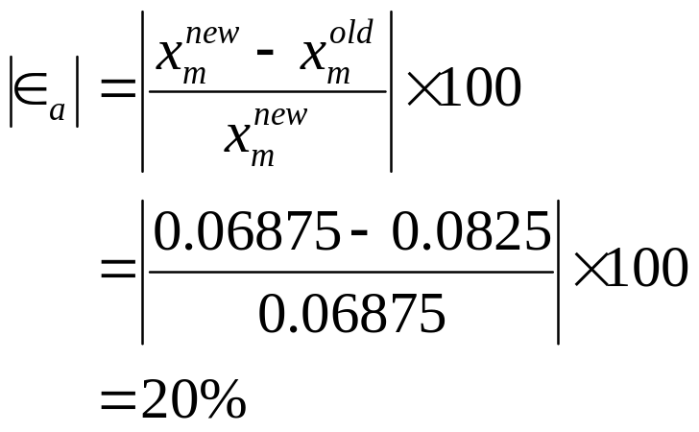


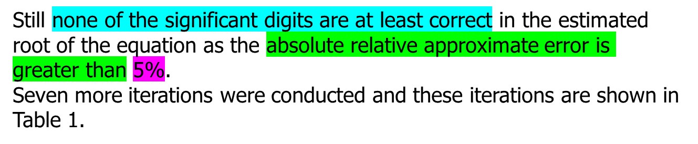
Example 1 Cont.
The absolute relative approximate error at the end of Iteration 3 is

Slide 27
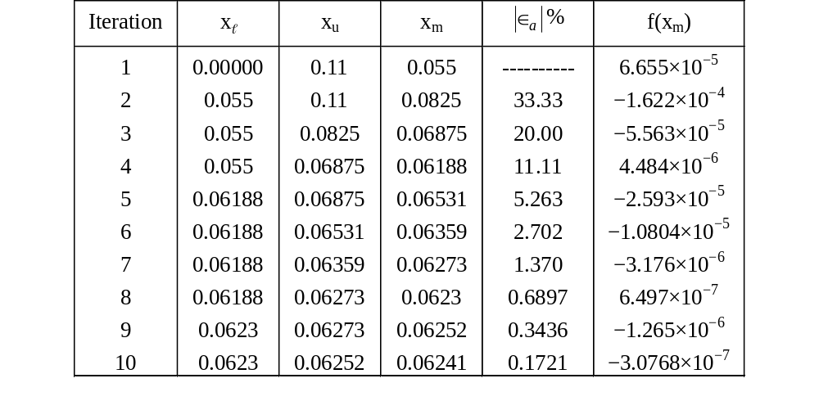





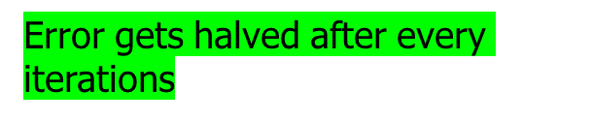
Table 1 Cont.
Table 1 Root of f(x)=0 as function of number of iterations for bisection method.

Slide 28
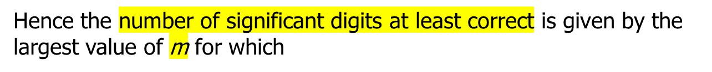

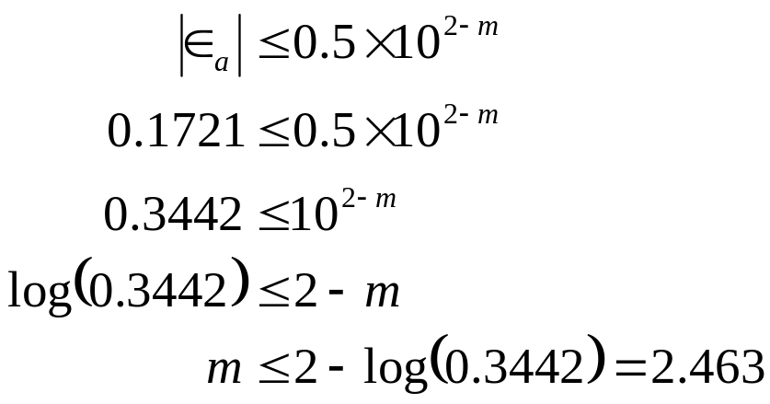




Table 1 Cont.
So
The number of significant digits at least correct in the estimated root of 0.06241 at the end of the 10th iteration is 2.

Slide 29

Always convergent
The root bracket gets halved with each iteration - guaranteed.

Slide 30

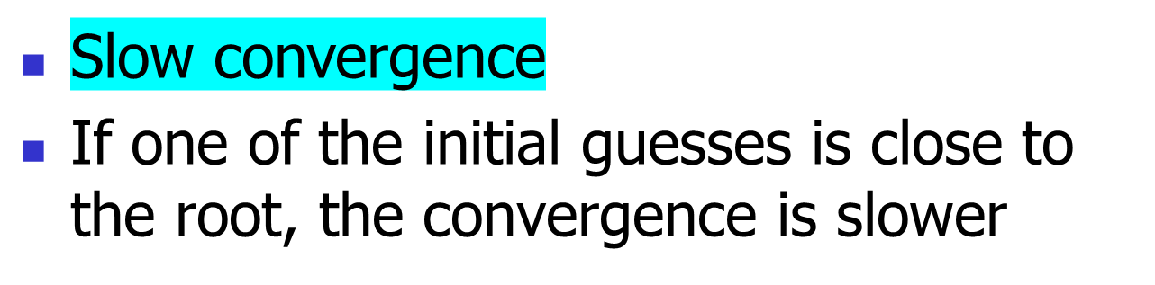

Slide 31
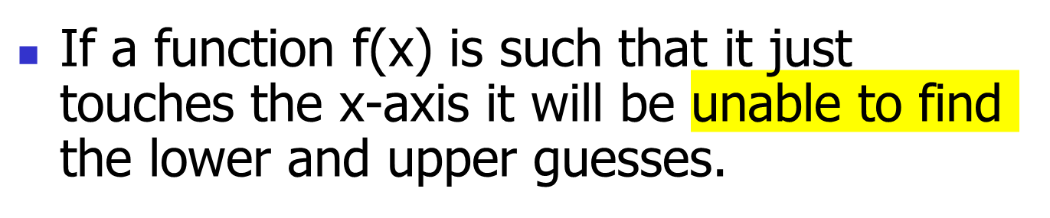
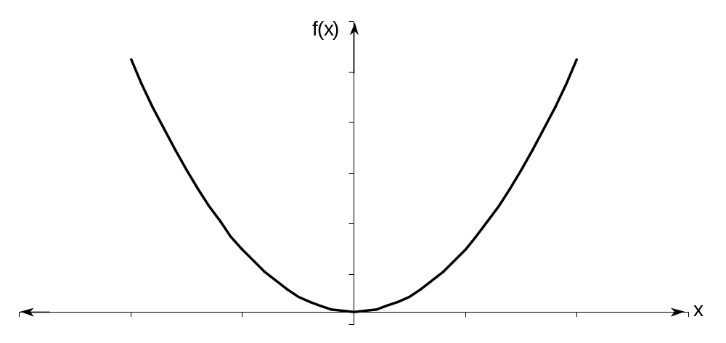
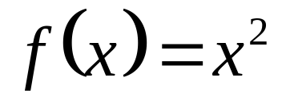



Drawbacks (continued)

Slide 32
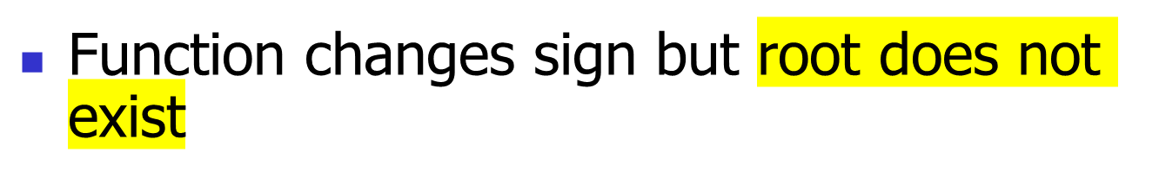
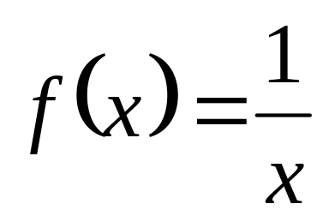




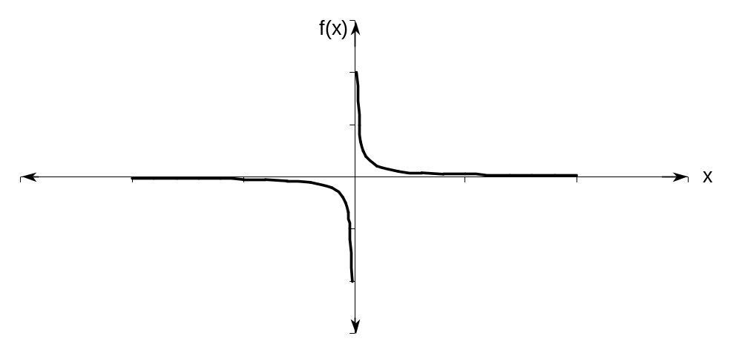



Drawbacks (continued)

Slide 33
THE END

